Slide 1
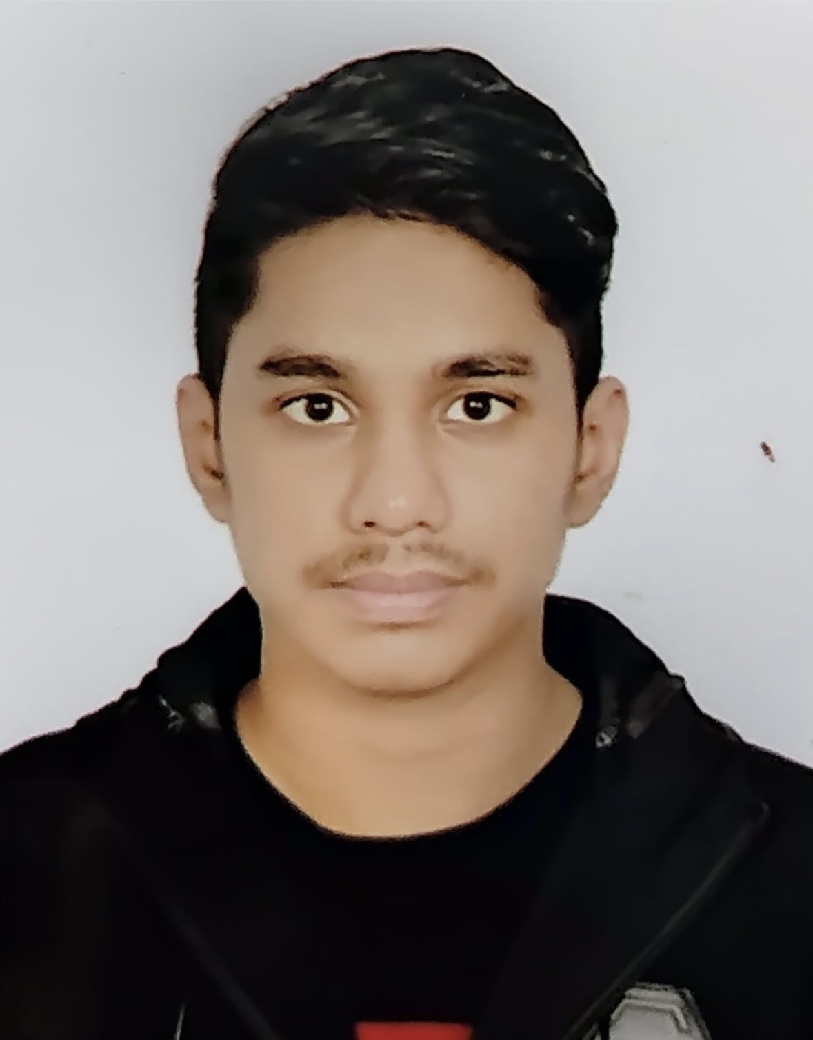
n
Profile :
Major in BBA in Human Resource Management at Independent University Bangladesh (IUB).
Minor in Marketing in BBA
_________________________________________________________
Jaiyan Al hasan
Contact
Larmini Street Wari,
DHAKA, 1203
+8801994226989
jaiyanalhasan4@gmail.com

Slide 2
Education
Idenpendent University Bangladesh ,
[BBA Major in HRM Minor in Marketing]
Maple Leaf International School .
[From 2008 to 2022 : O Levels & A Levels ]

Slide 3
Work Experience
Tutoring
Student programming
Parbo camping

Slide 4
Experiential Skills
Digital Marketing
MS. Work
MS. Excel
MS. Power point

Slide 5
Language
Bangla
English
Hindi

Slide 6
References
Sheik Mohammad Fauzul Azim Marketing
Officer, pathao
Email: azim2705@gmail.com
97 Asad Avenue, Mohammadpur, Dhaka- 120

